Slide 1
CLASS 4 : BASICS OF PYTHON FOR DATA SCIENCE

Slide 2
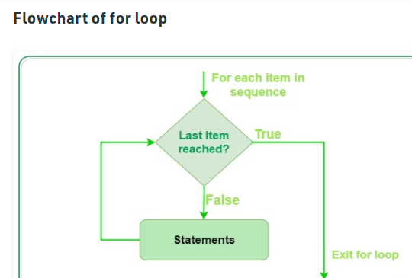
INTRODUCTION TO LOOPS
What are loops?
In computer programming, a loop is a sequence of instruction s that is continually repeated until a certain condition is reached. Typically, a certain process is done, such as getting an item of data and changing it, and then some condition is checked such as whether a counter has reached a prescribed number.
What are the 2 main types of loops in Python?
There are two types of loops in Python, for and while.

Slide 3
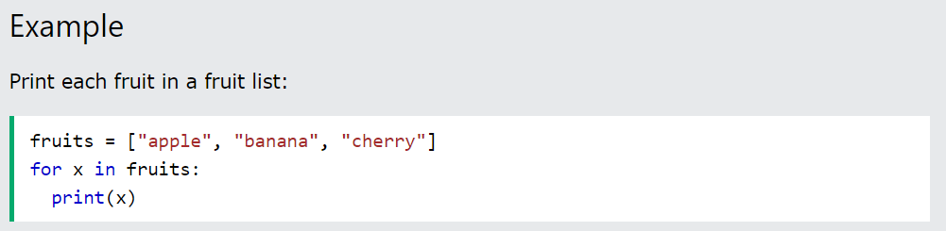
Python For Loops
A for loop is used for iterating over a sequence (that is either a list, a tuple, a dictionary, a set, or a string).
This is less like the for keyword in other programming languages, and works more like an iterator method as found in other object-orientated programming languages.
With the for loop we can execute a set of statements, once for each item in a list, tuple, set etc.
The for loop does not require an indexing variable to set beforehand.

Slide 4
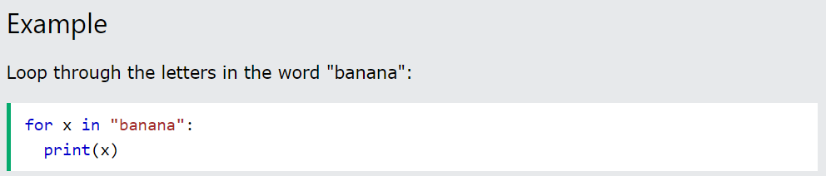
Looping Through a String
Even strings are iterable objects, they contain a sequence of characters:

Slide 5
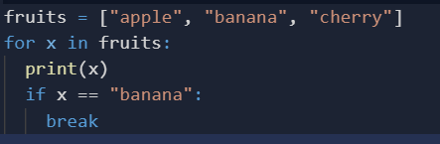
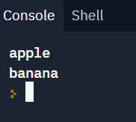
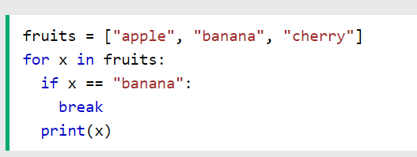
The break Statement
With the break statement we can stop the loop before it has looped through all the items:
Example
Exit the loop when x is "banana":
Example
Exit the loop when x is "banana", but this time the break comes before the print:

Slide 6
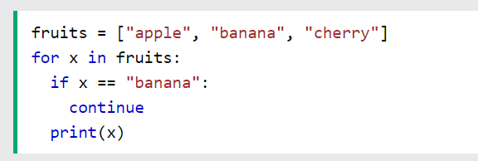
The continue Statement
With the continue statement we can stop the current iteration of the loop, and continue with the next:
Example
Do not print banana:

Slide 7
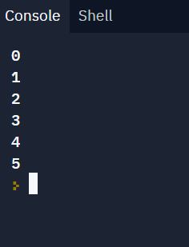

The range() Function
To loop through a set of code a specified number of times, we can use the range() function,
The range() function returns a sequence of numbers, starting from 0 by default, and increments by 1 (by default), and ends at a specified number.
Note that range(6) is not the values of 0 to 6, but the values 0 to 5.
The range() function defaults to 0 as a starting value, however it is possible to specify the starting value by adding a parameter: range(2, 6), which means values from 2 to 6 (but not including 6):

Slide 8
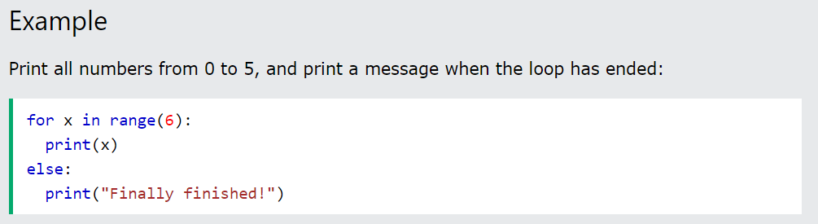
Else in For Loop
The else keyword in a for loop specifies a block of code to be executed when the loop is finished:
Note: The else block will NOT be executed if the loop is stopped by a break statement.

Slide 9
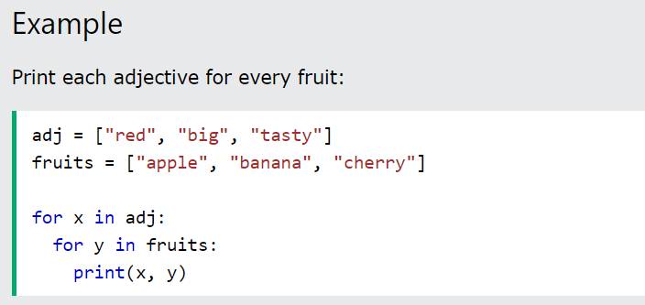
Nested Loops
A nested loop is a loop inside a loop.
The "inner loop" will be executed one time for each iteration of the "outer loop":
The pass Statement
for loops cannot be empty, but if you for some reason have a for loop with no content, put in the pass statement to avoid getting an error.

Slide 10
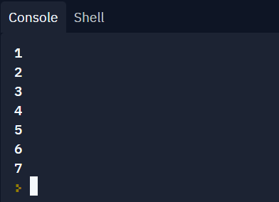
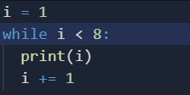
The while Loop
With the while loop we can execute a set of statements as long as a condition is true.
Note: remember to increment i, or else the loop will continue forever.
The while loop requires relevant variables to be ready, in this example we need to define an indexing variable, i, which we set to 1.

Slide 11
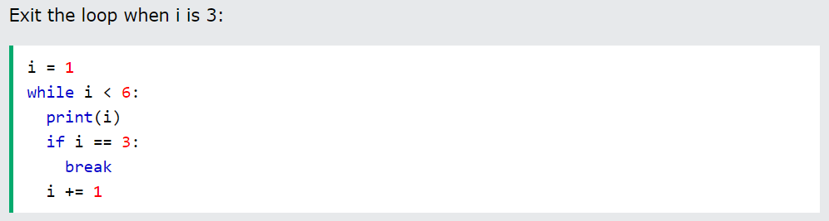
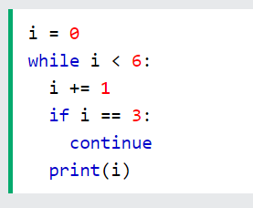
The break Statement
With the break statement we can stop the loop even if the while condition is true:
Example
The continue Statement
With the continue statement we can stop the current iteration, and continue with the next:
Example
Continue to the next iteration if i is 3:

Slide 12
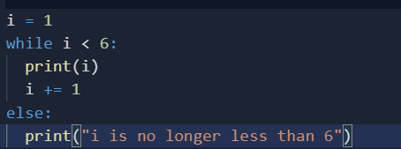
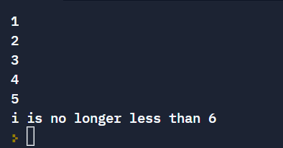
The else Statement
With the else statement we can run a block of code once when the condition no longer is true:
Example
Print a message once the condition is false:

Slide 13
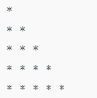
Certain questions for implementing the concept of loops
Q1. Iterate over a list in Python.
Solution :
# iterate over a list or print all elements present in a list
list = [1,2,3,4,5]
# Using for loop
For x in list:
print(i)
Q2. print the following pattern using loops in python.
n = 5
for i in range(0, n):
# inner loop to handle number of columns
# values changing acc. to outer loop
for j in range(0, i+1):
# printing stars
print("* ",end="")
# ending line after each row
print("\r")

Slide 14
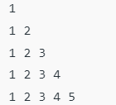
Q3 . Print the following code using loops.
Solution :
num = 1
n = 5
# outer loop to handle number of rows
for i in range(0, n):
# re assigning num
num = 1
# inner loop to handle number of columns
# values changing acc. to outer loop
for j in range(0, i+1):
# printing number
print(num, end=" ")
# incrementing number at each column
num = num + 1
# ending line after each row
print("\r")

Slide 15
Python Collections (Arrays)
There are four collection data types in the Python programming language:
List is a collection which is ordered and changeable. Allows duplicate members.
Tuple is a collection which is ordered and unchangeable. Allows duplicate members.
Set is a collection which is unordered, unchangeable*, and unindexed. No duplicate members.
Dictionary is a collection which is ordered** and changeable. No duplicate members.

Slide 16
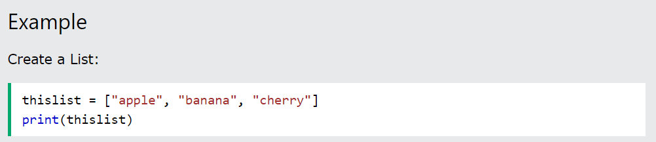
Python List
Lists are used to store multiple items in a single variable.
Lists are one of 4 built-in data types in Python used to store collections of data, the other 3 are Tuple, Set, and Dictionary, all with different qualities and usage.
Lists are created using square brackets:
List Items
List items are ordered, changeable, and allow duplicate values.
List items are indexed, the first item has index [0], the second item has index [1] etc.

Slide 17
Ordered
When we say that lists are ordered, it means that the items have a defined order, and that order will not change.
If you add new items to a list, the new items will be placed at the end of the list.
Note: There are some list methods that will change the order, but in general: the order of the items will not change.
Changeable
The list is changeable, meaning that we can change, add, and remove items in a list after it has been created.

Slide 18
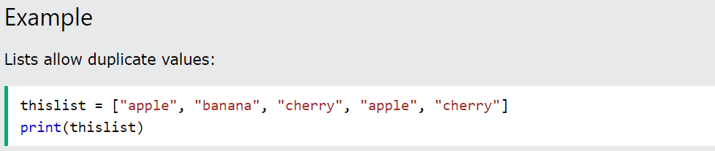
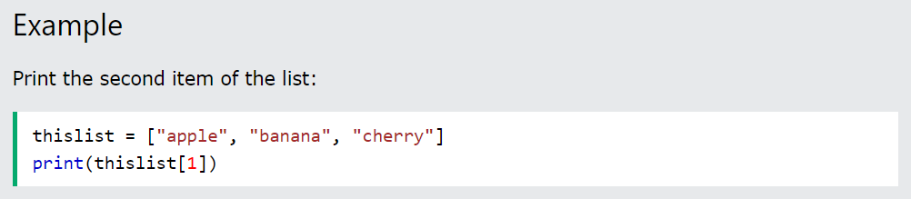
Allow Duplicates
Since lists are indexed, lists can have items with the same value:
Access Items
List items are indexed and you can access them by referring to the index number:
Note: The first item has index 0.

Slide 19
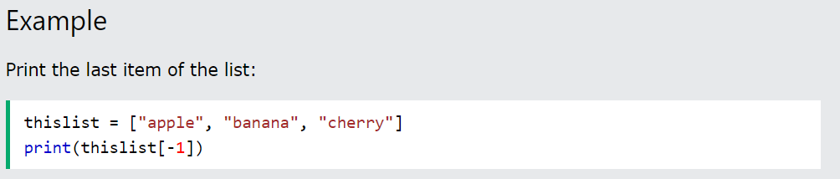
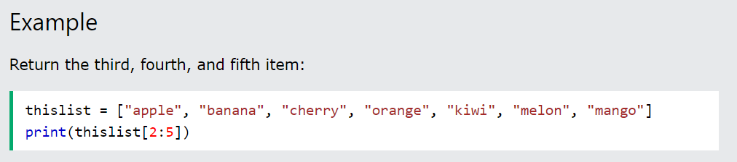
Negative Indexing
Negative indexing means start from the end
-1 refers to the last item, -2 refers to the second last item etc.
Range of Indexes
You can specify a range of indexes by specifying where to start and where to end the range.
When specifying a range, the return value will be a new list with the specified items.

Slide 20
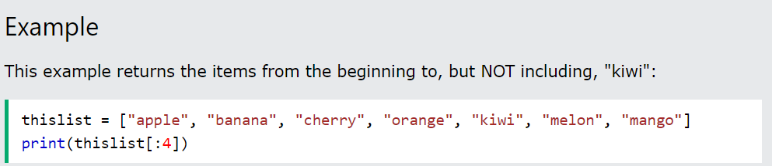
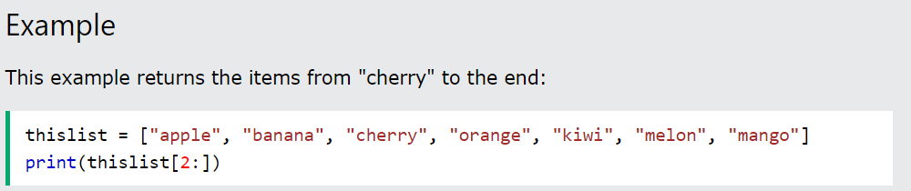
By leaving out the start value, the range will start at the first item:
By leaving out the end value, the range will go on to the end of the list:

Slide 21
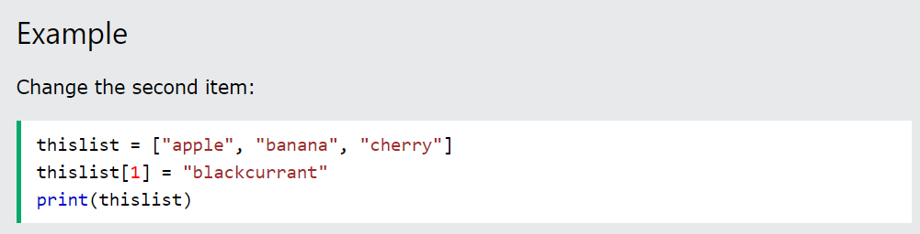
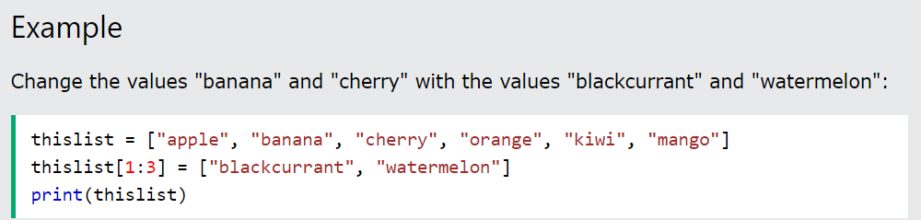
Change Item Value
To change the value of a specific item, refer to the index number:
Change a Range of Item Values
To change the value of items within a specific range, define a list with the new values, and refer to the range of index numbers where you want to insert the new values:

Slide 22
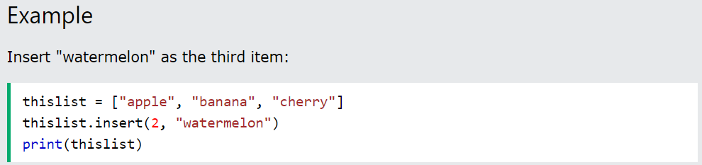
Note: The length of the list will change when the number of items inserted does not match the number of items replaced.
Insert Items
To insert a new list item, without replacing any of the existing values, we can use the insert() method.
The insert() method inserts an item at the specified index:
Append Items
To add an item to the end of the list, use the append() method:

Slide 23
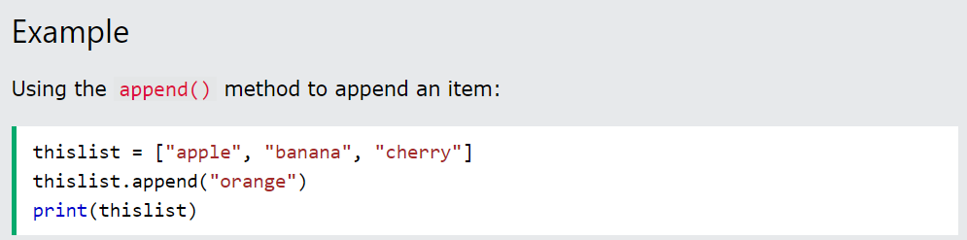
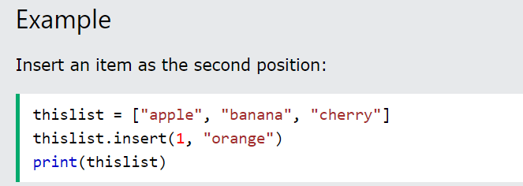
Python - Add List Items
Append Items
To add an item to the end of the list, use the append() method:
Insert Items
To insert a list item at a specified index, use the insert() method.
The insert() method inserts an item at the specified index:

Slide 24
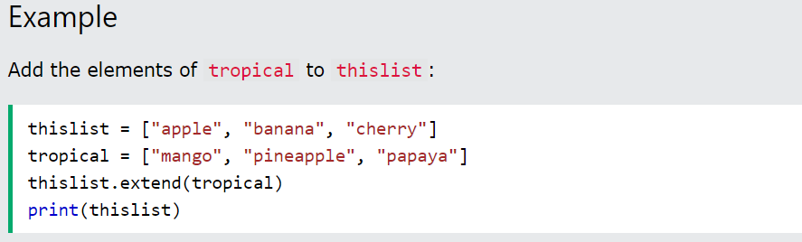
Extend List
To append elements from another list to the current list, use the extend() method.
The elements will be added to the end of the list.

Slide 25
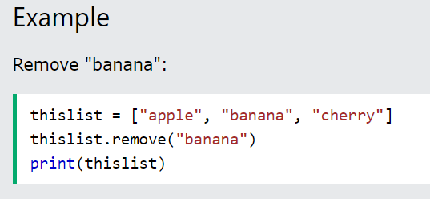
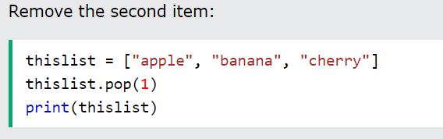
Python - Remove List Items
Remove Specified Item
The remove() method removes the specified item.
Remove Specified Index
The pop() method removes the specified index.

Slide 26
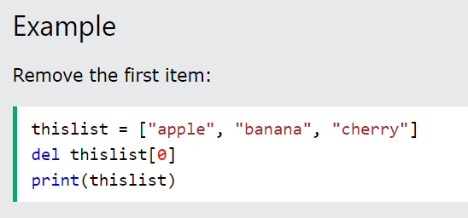
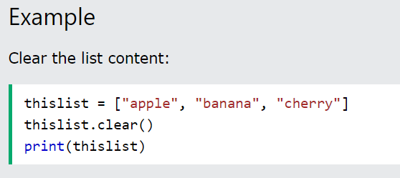
The del keyword also removes the specified index:
Clear the List
The clear() method empties the list.
The list still remains, but it has no content.
Example

Slide 27
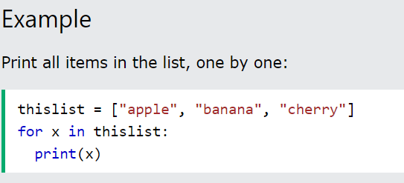
Python - Loop Lists
Loop Through a List
You can loop through the list items by using a for loop:

Slide 28
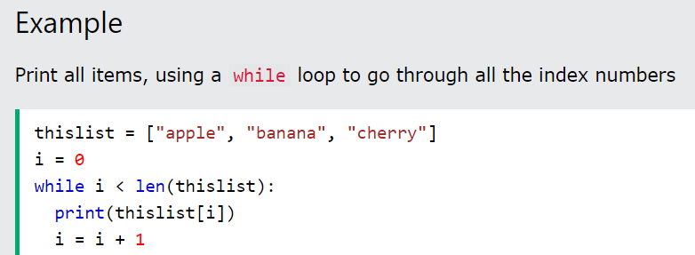
Using a While Loop
You can loop through the list items by using a while loop.
Use the len() function to determine the length of the list, then start at 0 and loop your way through the list items by refering to their indexes.
Remember to increase the index by 1 after each iteration.

Slide 29
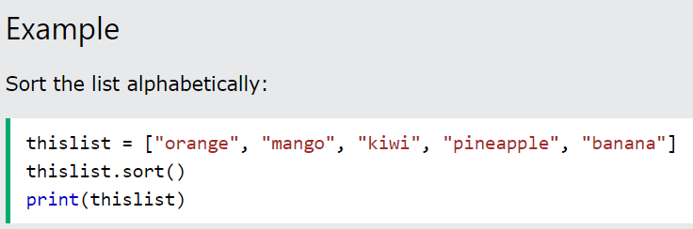
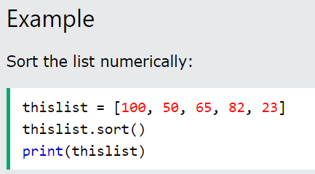
Python - Sort Lists
Sort List Alphanumerically
List objects have a sort() method that will sort the list alphanumerically, ascending, by default:

Slide 30
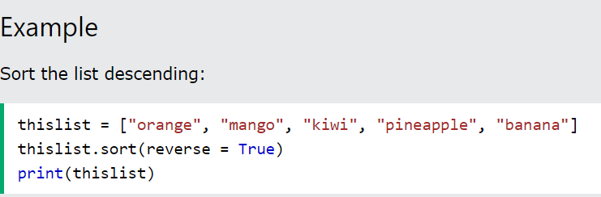
Sort Descending
To sort descending, use the keyword argument reverse = True:
OUTPUT :

Slide 31
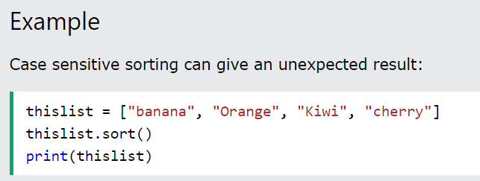
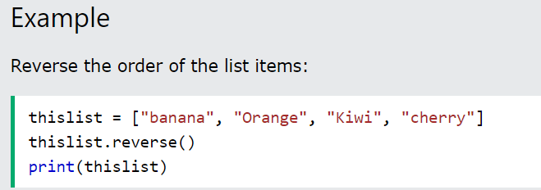
Case Insensitive Sort
By default the sort() method is case sensitive, resulting in all capital letters being sorted before lower case letters:
Reverse Order
What if you want to reverse the order of a list, regardless of the alphabet?
The reverse() method reverses the current sorting order of the elements.

Slide 32
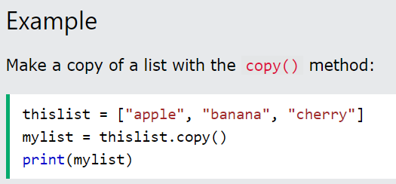
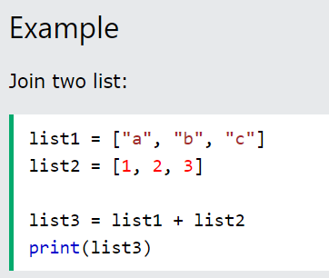
Copy a List
You cannot copy a list simply by typing list2 = list1, because: list2 will only be a reference to list1, and changes made in list1 will automatically also be made in list2.
There are ways to make a copy, one way is to use the built-in List method copy().
Join Two Lists
There are several ways to join, or concatenate, two or more lists in Python.
One of the easiest ways are by using the + operator.

Slide 33
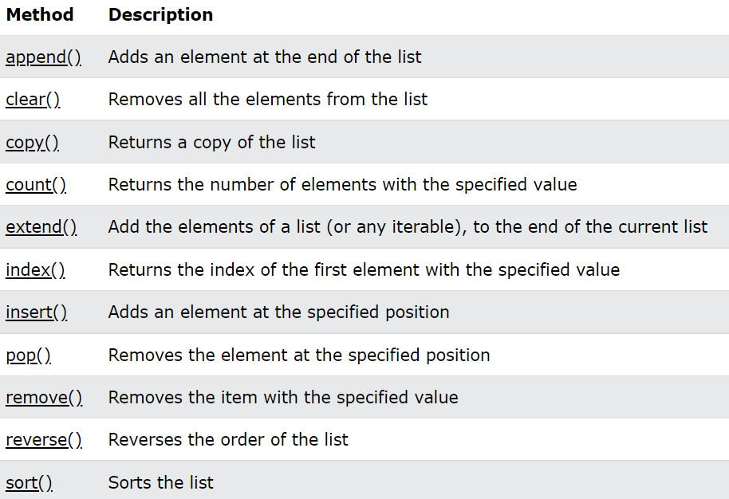
List Methods
Python has a set of built-in methods that you can use on lists.

Slide 34
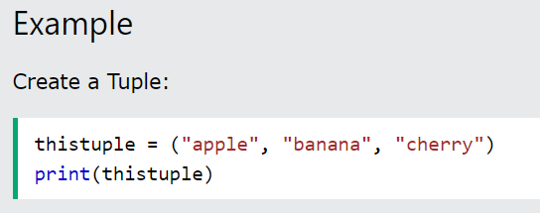
Python Tuples
Tuple
Tuples are used to store multiple items in a single variable.
Tuple is one of 4 built-in data types in Python used to store collections of data, the other 3 are List, Set, and Dictionary, all with different qualities and usage.
A tuple is a collection which is ordered and unchangeable.
Tuples are written with round brackets.

Slide 35
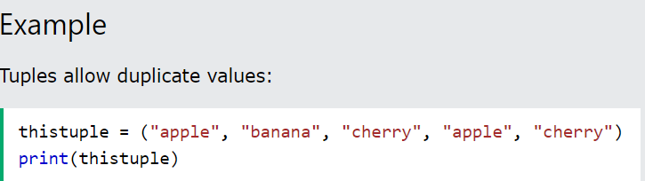
Tuple Items
Tuple items are ordered, unchangeable, and allow duplicate values.
Tuple items are indexed, the first item has index [0], the second item has index [1] etc.
Ordered
When we say that tuples are ordered, it means that the items have a defined order, and that order will not change.
Unchangeable
Tuples are unchangeable, meaning that we cannot change, add or remove items after the tuple has been created.
Allow Duplicates
Since tuples are indexed, they can have items with the same value:

Slide 36
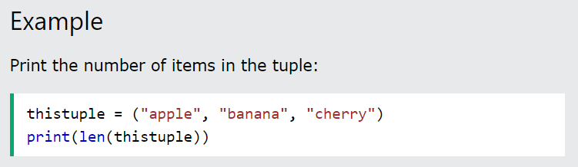
Tuple Length
To determine how many items a tuple has, use the len() function

Slide 37

Tuple Items - Data Types
Tuple items can be of any data type:
Example
String, int and boolean data types:
A tuple can contain different data types:
Example
A tuple with strings, integers and boolean values:
tuple1 = ("abc", 34, True, 40, "male")

Slide 38
The tuple() Constructor
It is also possible to use the tuple() constructor to make a tuple.
Example
Using the tuple() method to make a tuple:
thistuple = tuple(("apple", "banana", "cherry")) # note the double round-brackets print(thistuple)

Slide 39
Python - Access Tuple Items
Access Tuple Items
You can access tuple items by referring to the index number, inside square brackets:
Example
Print the second item in the tuple:
thistuple = ("apple", "banana", "cherry") print(thistuple[1])
Note: The first item has index 0.
Negative Indexing
Negative indexing means start from the end.
-1 refers to the last item, -2 refers to the second last item etc.
Example
Print the last item of the tuple:
thistuple = ("apple", "banana", "cherry") print(thistuple[-1])

Slide 40
Range of Indexes
You can specify a range of indexes by specifying where to start and where to end the range.
When specifying a range, the return value will be a new tuple with the specified items.
Example
Return the third, fourth, and fifth item:
thistuple = ("apple", "banana", "cherry", "orange", "kiwi", "melon", "mango") print(thistuple[2:5])

Slide 41
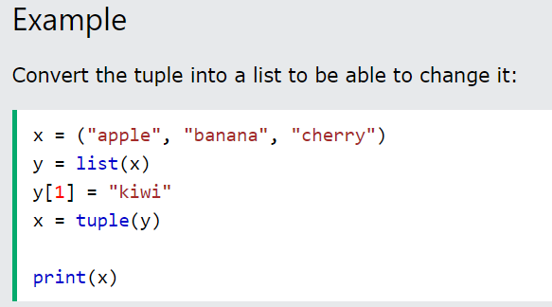
Python - Update Tuples
❮
Tuples are unchangeable, meaning that you cannot change, add, or remove items once the tuple is created.
But there are some workarounds.
Change Tuple Values
Once a tuple is created, you cannot change its values. Tuples are unchangeable, or immutable as it also is called.
But there is a workaround. You can convert the tuple into a list, change the list, and convert the list back into a tuple.

Slide 42
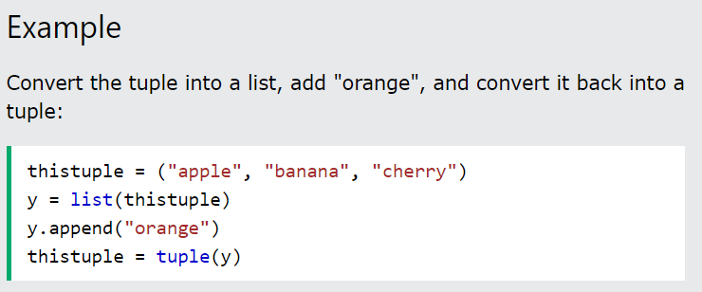
Add Items
Since tuples are immutable, they do not have a build-in append() method, but there are other ways to add items to a tuple.
1. Convert into a list: Just like the workaround for changing a tuple, you can convert it into a list, add your item(s), and convert it back into a tuple.

Slide 43

2. Add tuple to a tuple.
You are allowed to add tuples to tuples, so if you want to add one item, (or many), create a new tuple with the item(s), and add it to the existing tuple:

Slide 44
Remove Items
Note: You cannot remove items in a tuple.
Tuples are unchangeable, so you cannot remove items from it, but you can use the same workaround as we used for changing and adding tuple items:
Example
Convert the tuple into a list, remove "apple", and convert it back into a tuple
Or you can delete the tuple completely:
Example
The del keyword can delete the tuple completely:
thistuple = ("apple", "banana", "cherry") del thistuple print(thistuple) #this will raise an error because the tuple no longer exists

Slide 45

Using Asterisk*
If the number of variables is less than the number of values, you can add an * to the variable name and the values will be assigned to the variable as a list:

Slide 46

If the asterisk is added to another variable name than the last, Python will assign values to the variable until the number of values left matches the number of variables left.

Slide 47

Python - Loop Tuples
Loop Through a Tuple
You can loop through the tuple items by using a for loop

Slide 48

Using a While Loop
You can loop through the list items by using a while loop.
Use the len() function to determine the length of the tuple, then start at 0 and loop your way through the tuple items by refering to their indexes.
Remember to increase the index by 1 after each iteration.

Slide 49

Join Two Tuples
To join two or more tuples you can use the + operator:

Slide 50

Multiply Tuples
If you want to multiply the content of a tuple a given number of times, you can use the * operator:

Slide 51

Python Sets
Set
Sets are used to store multiple items in a single variable.
Set is one of 4 built-in data types in Python used to store collections of data, the other 3 are List, Tuple, and Dictionary, all with different qualities and usage.
A set is a collection which is unordered, unchangeable*, and unindexed.
* Note: Set items are unchangeable, but you can remove items and add new items.
Sets are written with curly brackets.

Slide 52
Duplicates Not Allowed
Sets cannot have two items with the same value.
Example
Duplicate values will be ignored:
thisset = {"apple", "banana", "cherry", "apple"} print(thisset)
Get the Length of a Set
To determine how many items a set has, use the len() method.
Set Items - Data Types
Set items can be of any data type:
A set can contain different data types:

Slide 53
Access Items
You cannot access items in a set by referring to an index or a key.
But you can loop through the set items using a for loop, or ask if a specified value is present in a set, by using the in keyword.
Example
Loop through the set, and print the values:
thisset = {"apple", "banana", "cherry"} for x in thisset: print(x)
Change Items
Once a set is created, you cannot change its items, but you can add new items.

Slide 54

Add Items
Once a set is created, you cannot change its items, but you can add new items.
To add one item to a set use the add() method.

Slide 55
Python - Remove Set Items
Remove Item
To remove an item in a set, use the remove(), or the discard() method.
Note: If the item to remove does not exist, remove() will raise an error.
Note: If the item to remove does not exist, discard() will NOT raise an error.
You can also use the pop() method to remove an item, but this method will remove the last item. Remember that sets are unordered, so you will not know what item that gets removed.
The return value of the pop() method is the removed item.

Slide 56

Loop Items
You can loop through the set items by using a for loop:

Slide 57

Join Two Sets
There are several ways to join two or more sets in Python.
You can use the union() method that returns a new set containing all items from both sets, or the update() method that inserts all the items from one set into another:
Note: Both union() and update() will exclude any duplicate items.

Slide 58

Keep ONLY the Duplicates
The intersection_update() method will keep only the items that are present in both sets.
The intersection() method will return a new set, that only contains the items that are present in both sets.

Slide 59

Keep All, But NOT the Duplicates
The symmetric_difference_update() method will keep only the elements that are NOT present in both sets.

Slide 60

The symmetric_difference() method will return a new set, that contains only the elements that are NOT present in both sets.

Slide 61

Set Methods

Slide 62

Python Dictionaries
Dictionary
Dictionaries are used to store data values in key:value pairs.
A dictionary is a collection which is ordered*, changeable and does not allow duplicates.
As of Python version 3.7, dictionaries are ordered. In Python 3.6 and earlier, dictionaries are unordered.
Dictionaries are written with curly brackets, and have keys and values:

Slide 63

Dictionary Items
Dictionary items are ordered, changeable, and does not allow duplicates.
Dictionary items are presented in key:value pairs, and can be referred to by using the key name.

Slide 64

Changeable
Dictionaries are changeable, meaning that we can change, add or remove items after the dictionary has been created.
Duplicates Not Allowed
Dictionaries cannot have two items with the same key:

Slide 65
Dictionary Length
To determine how many items a dictionary has, use the len() function
Dictionary Items - Data Types
The values in dictionary items can be of any data type:

Slide 66


Python - Access Dictionary Items
Accessing Items
You can access the items of a dictionary by referring to its key name, inside square brackets:
Example
Get Keys
The keys() method will return a list of all the keys in the dictionary.
Example

Slide 67

Change Values
You can change the value of a specific item by referring to its key name:
Update Dictionary
The update() method will update the dictionary with the items from the given argument.
The argument must be a dictionary, or an iterable object with key:value pairs.

Slide 68

Python - Add Dictionary Items
❮ Previ
Adding Items
Adding an item to the dictionary is done by using a new index key and assigning a value to it:

Slide 69


Python - Remove Dictionary Items
Removing Items
There are several methods to remove items from a dictionary:
Example
The pop() method removes the item with the specified key name:

Slide 70



Slide 71



Loop Through a Dictionary
You can loop through a dictionary by using a for loop.
When looping through a dictionary, the return value are the keys of the dictionary, but there are methods to return the values as well.

Slide 72

Copy a Dictionary
You cannot copy a dictionary simply by typing dict2 = dict1, because: dict2 will only be a reference to dict1, and changes made in dict1 will automatically also be made in dict2.
There are ways to make a copy, one way is to use the built-in Dictionary method copy()

Slide 73

Another way to make a copy is to use the built-in function dict().

Slide 74

Python - Nested Dictionaries
❮ PrevioNext ❯
Nested Dictionaries
A dictionary can contain dictionaries, this is called nested dictionaries.

Slide 75

Dictionary Methods
Python has a set of built-in methods that you can use on dictionaries.

Slide 76

TO DEVELOP ONE’S PROGRAMMING SKILLS , ONE SHOULD FOCUS ON THEIR PROBLEM SOLVING ABILITY AND LOGICAL THINKING. RIDDLES ARE A GREAT WAY TO AID BOTH THESE SKILLS
TRY SOLVING THIS!

Slide 77

SOLUTION :

